Slide 1

Real-Time Data with Web Sockets
Dileep Kumar
023-21-0057

Slide 2


Agenda
HTTP
WEB SOCKETS
SOCKET.IO AND PUSHER
Applications of Real-Time Data with WebSockets

Slide 3
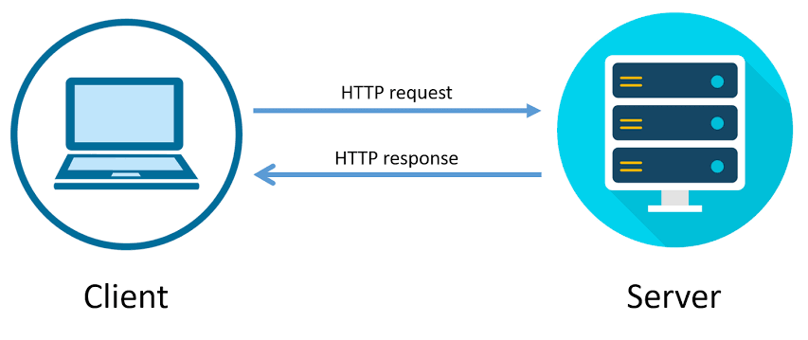
HTTP
Traditional web applications rely on HTTP requests for data.
Client (browser) sends a request to the server.
Server processes the request and sends a response

Slide 4
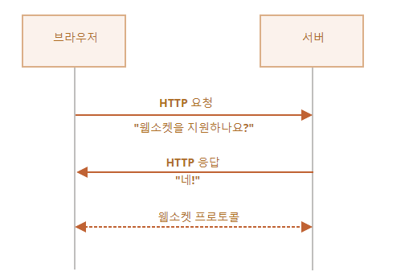
Web Sockets
WebSockets are an advanced technology that allows for two-way interactive communication between a client's browser and a server.
WebSockets use a TCP connection
They allow for full-duplex communication

Slide 5
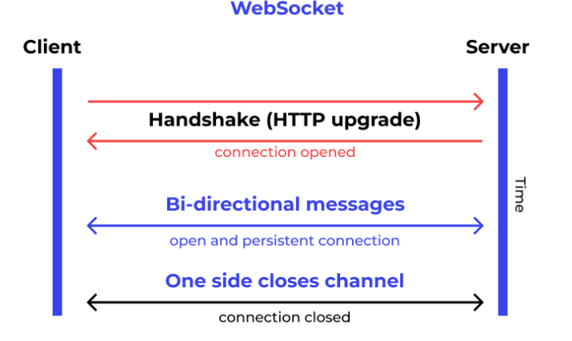
Web sockets continue..
Connection: upgrade
Upgrade: websocket
Websocket-key: “Key”
HTTP 101

Slide 6
SOCKET.IO AND PUSHER
Socket.IO
Pusher
A popular library for real-time, bidirectional, and event-based communication between the browser and the server.
Offers additional features over plain WebSockets, such as reliability, automatic reconnection, and broadcasting to subsets of clients.
A hosted service that makes it easy to add real-time functionality to web and mobile applications.
Acts as a real-time layer between servers and clients, maintaining persistent connections over WebSocket and falling back to HTTP if necessary.

Slide 7
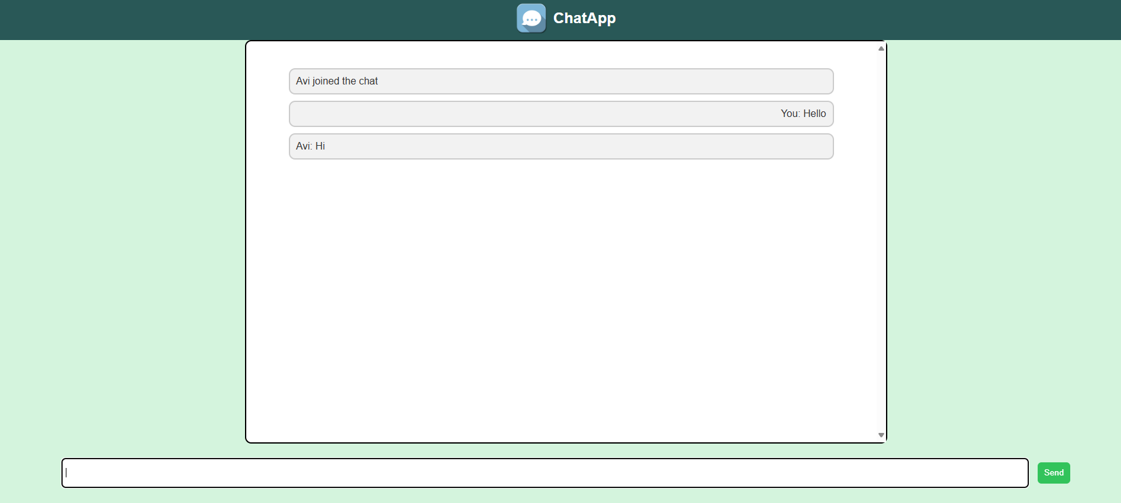
Applications of Real-Time Data with WebSockets

Slide 8
Thank you
Questions?

